Slide 1
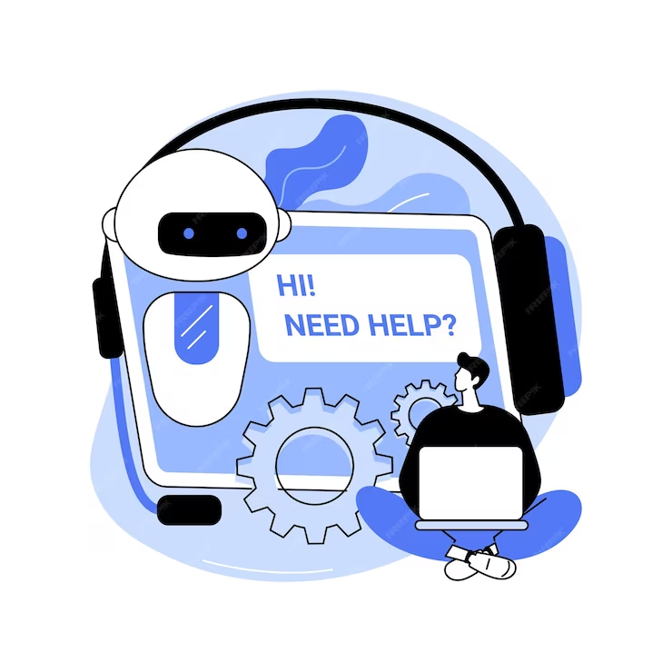
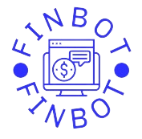
FIN BOT: FINANCE AI
BRYAN FERNANDO KURNIAWAN SUHARTONO – 2602079804
BRYAN ORVILLE AUDRIC – 2602160750
CALVIN FARRELLINO KURNIAWAN – 2602085883
DODDY SURYADHARMA – 2602062236
JONATHAN EDMUND WILLIAM - 2602152982

Slide 2
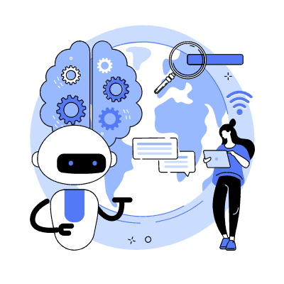
Contents
1
Problem Statement
2
Target market
3
Finbot overview
4
Goals and monetization
5
Artificial Intelligence technology
6
Prototype

Slide 3
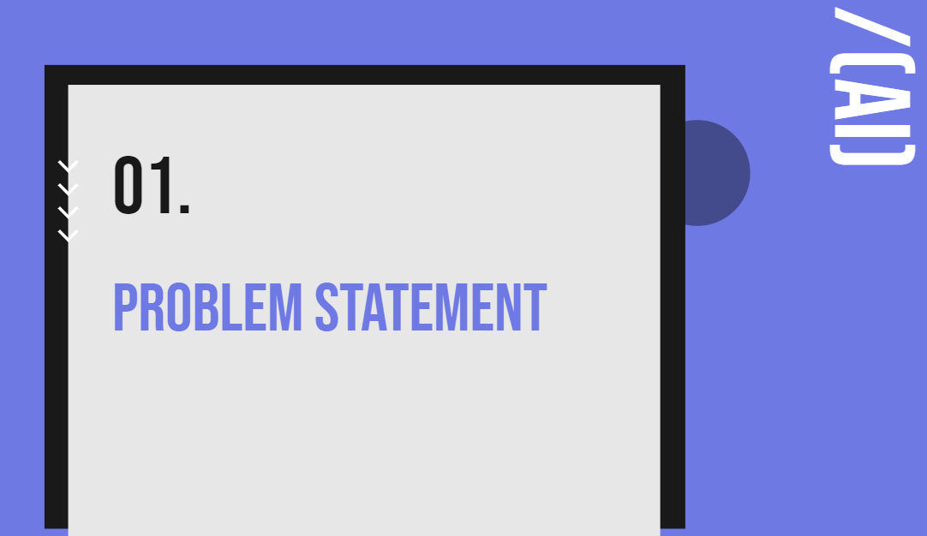

Slide 4

Problem Statement
High Cost
Traditional financial advisor require high fees, limiting access for several small to mid-sized company.
Human error
Traditional advisor can miscalculate, causing an inaccurate prediction, hence providing an inaccurate financial advices
Time Consuming
Traditional financial advisory services often involve time-consuming processes, leading to delayed responses in addressing urgent financial matters or adapting to rapidly changing market conditions.
Limited Accessibility
Traditional financial advisory services are often geographically constrained, making it challenging for individuals in remote or underserved areas to access expert financial guidance.

Slide 5
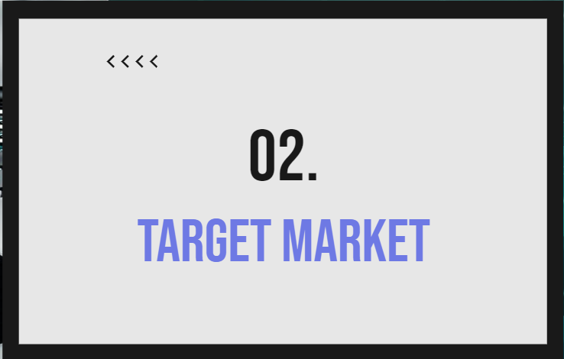

Slide 6
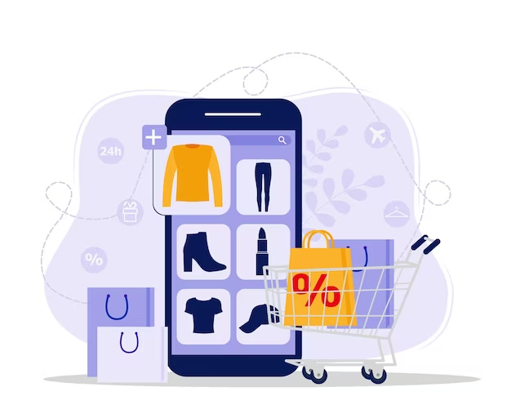
Market trend
The demand for data-driven decision-making, continuous monitoring and cost-effectiveness personalization in finance, further highlight the needs for AI financial advisor

Slide 7

Target Market
Corporation looking to sustain their operations
Mid to large-sized corporation looking to expand their operations

Slide 8

03.
FInbot Overview

Slide 9
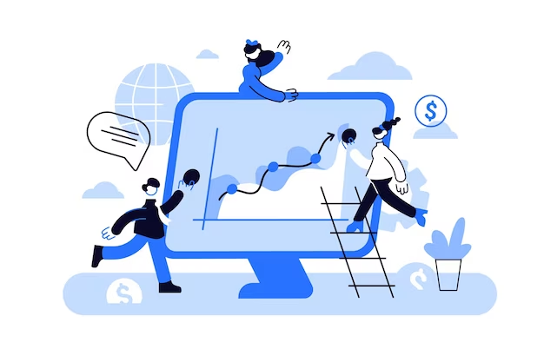
Overview
Finbot offers a suite of services, empowering users with financial advice, real-time market insights and performance tracking. With a focus on continuous learning, Finbot ensures clients a secure advice with 24/7 accessibility.
Financial performance tracking
Financial Advice
Detailed tracking and analysis of company performance for informed decision-making.
Displaying company current and predicted financial statistic data with benchmark feature.
Tailored investment plans driven by sophisticated algorithms and market analysis, giving you the best financial advice based on company performance.

Slide 10
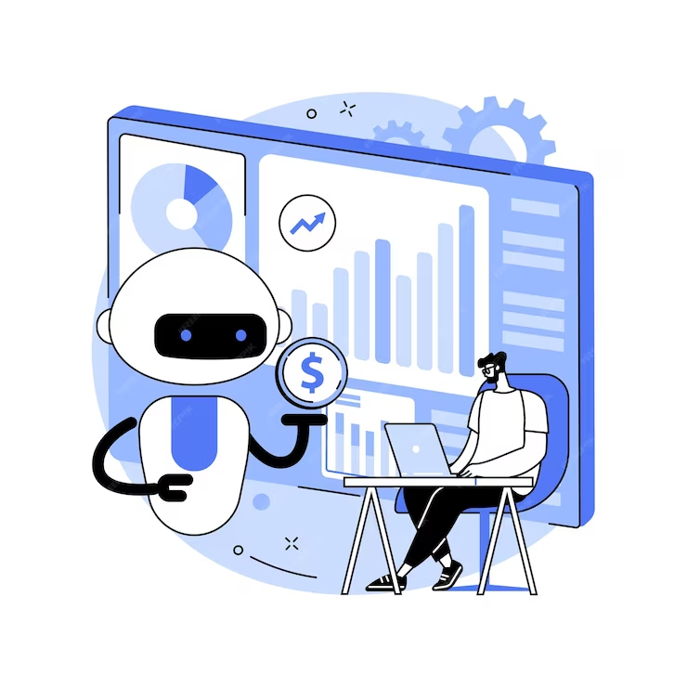
04.
Goals and monetization

Slide 11


Goals & Monetization
Short-term
Offer a basic version of the Finbot for free with limited features, and charge users as subscription plan for access to premium features or advanced functionalities. The aim of this short-term operation is to obtain as much data as possible to create a highly functional AI Financial Advisor
Long-term
Partner with a corporation that needs the service and charge a partner fee

Slide 12
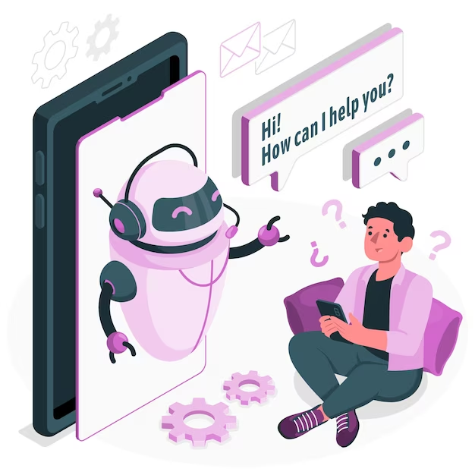
05.
AI technology

Slide 13
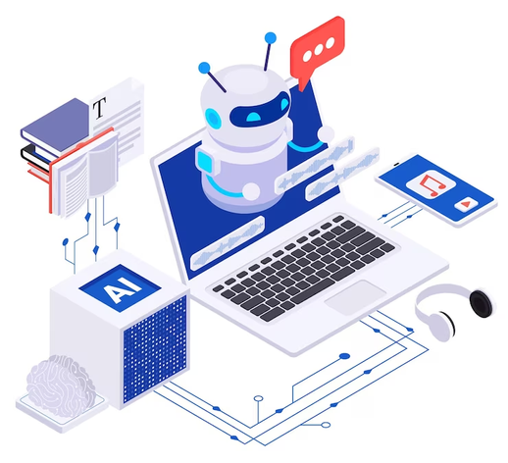
AI technology
Natural Language generation
This involves using natural language processing algorithms to analyze unstructured data and automatically produce content based on that data.
Machine learning
Machine learning is a subfield of artificial intelligence (AI) that focuses on the development of algorithms and statistical models that enable computer systems to improve their performance on a specific task through learning from data, without being explicitly programmed.

Slide 14
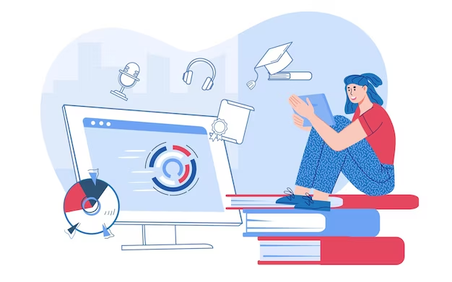
06.
Prototype

Slide 15
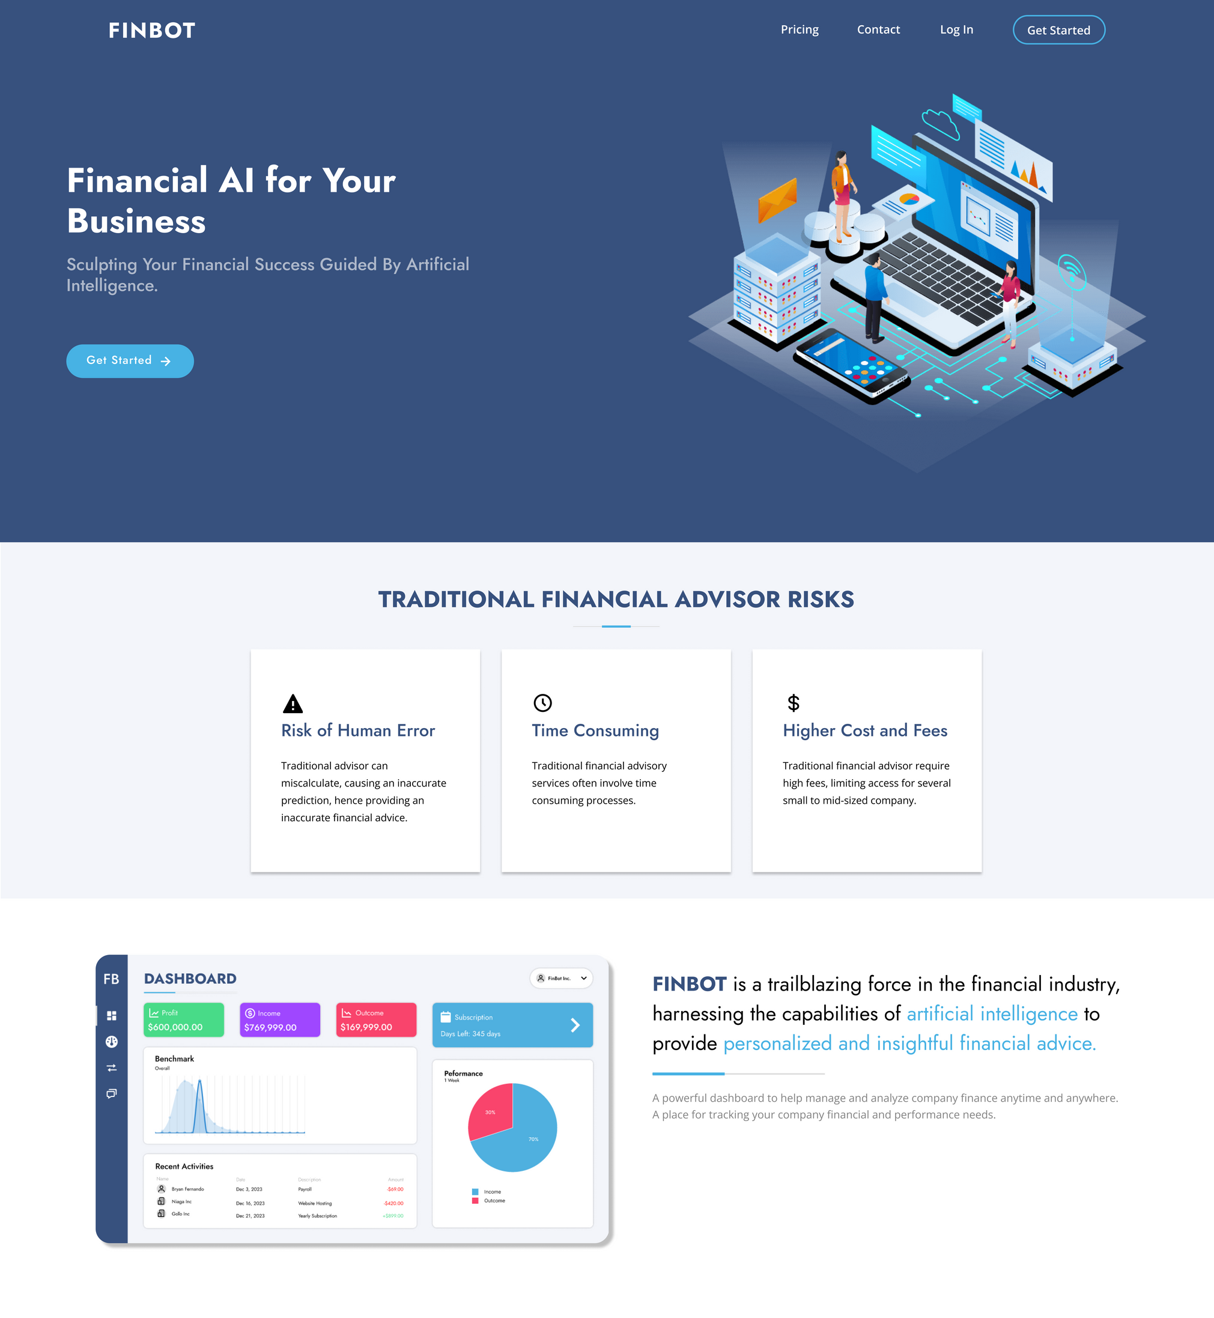
Landing Page

Slide 16
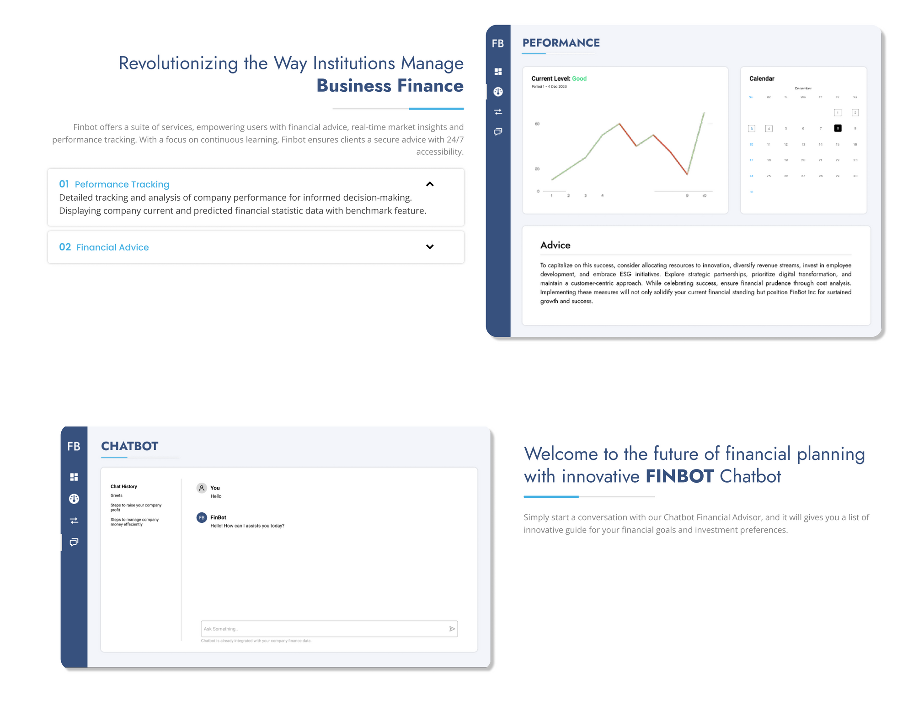
Landing Page

Slide 17
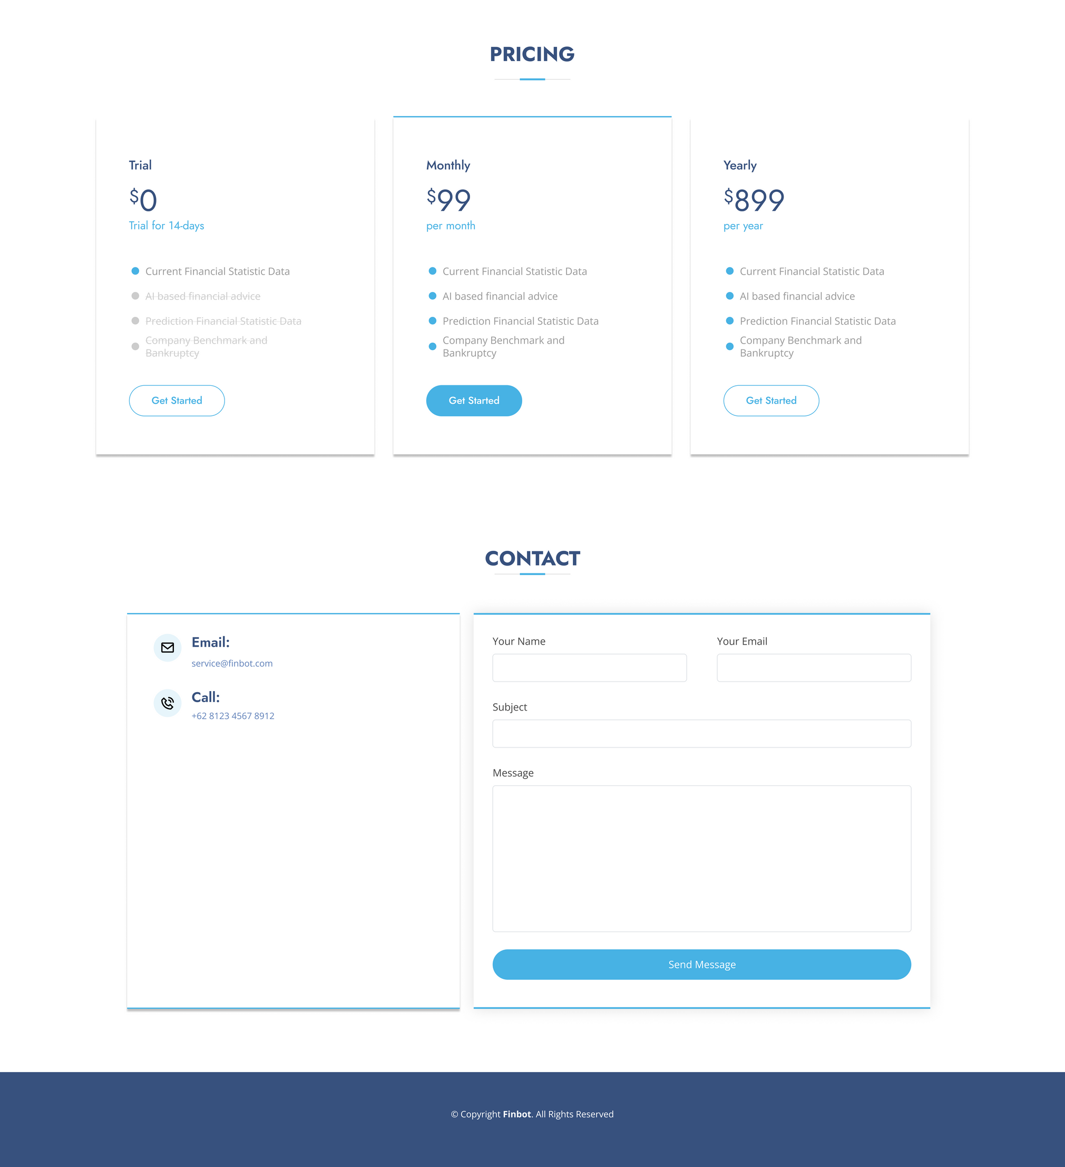
Landing Page

Slide 18
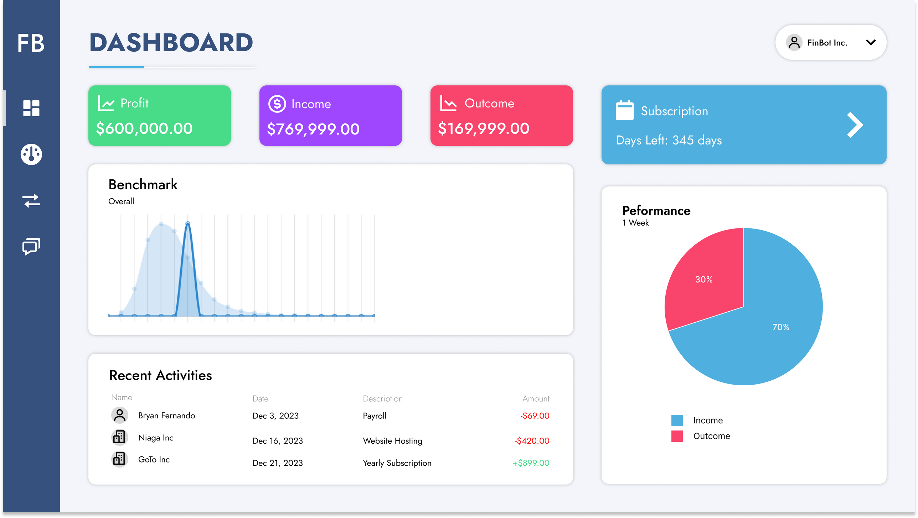
Dashboard

Slide 19
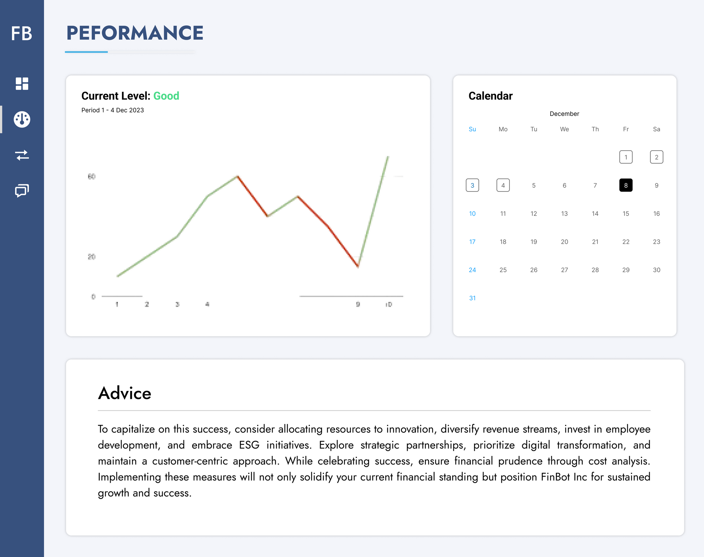
Performance

Slide 20
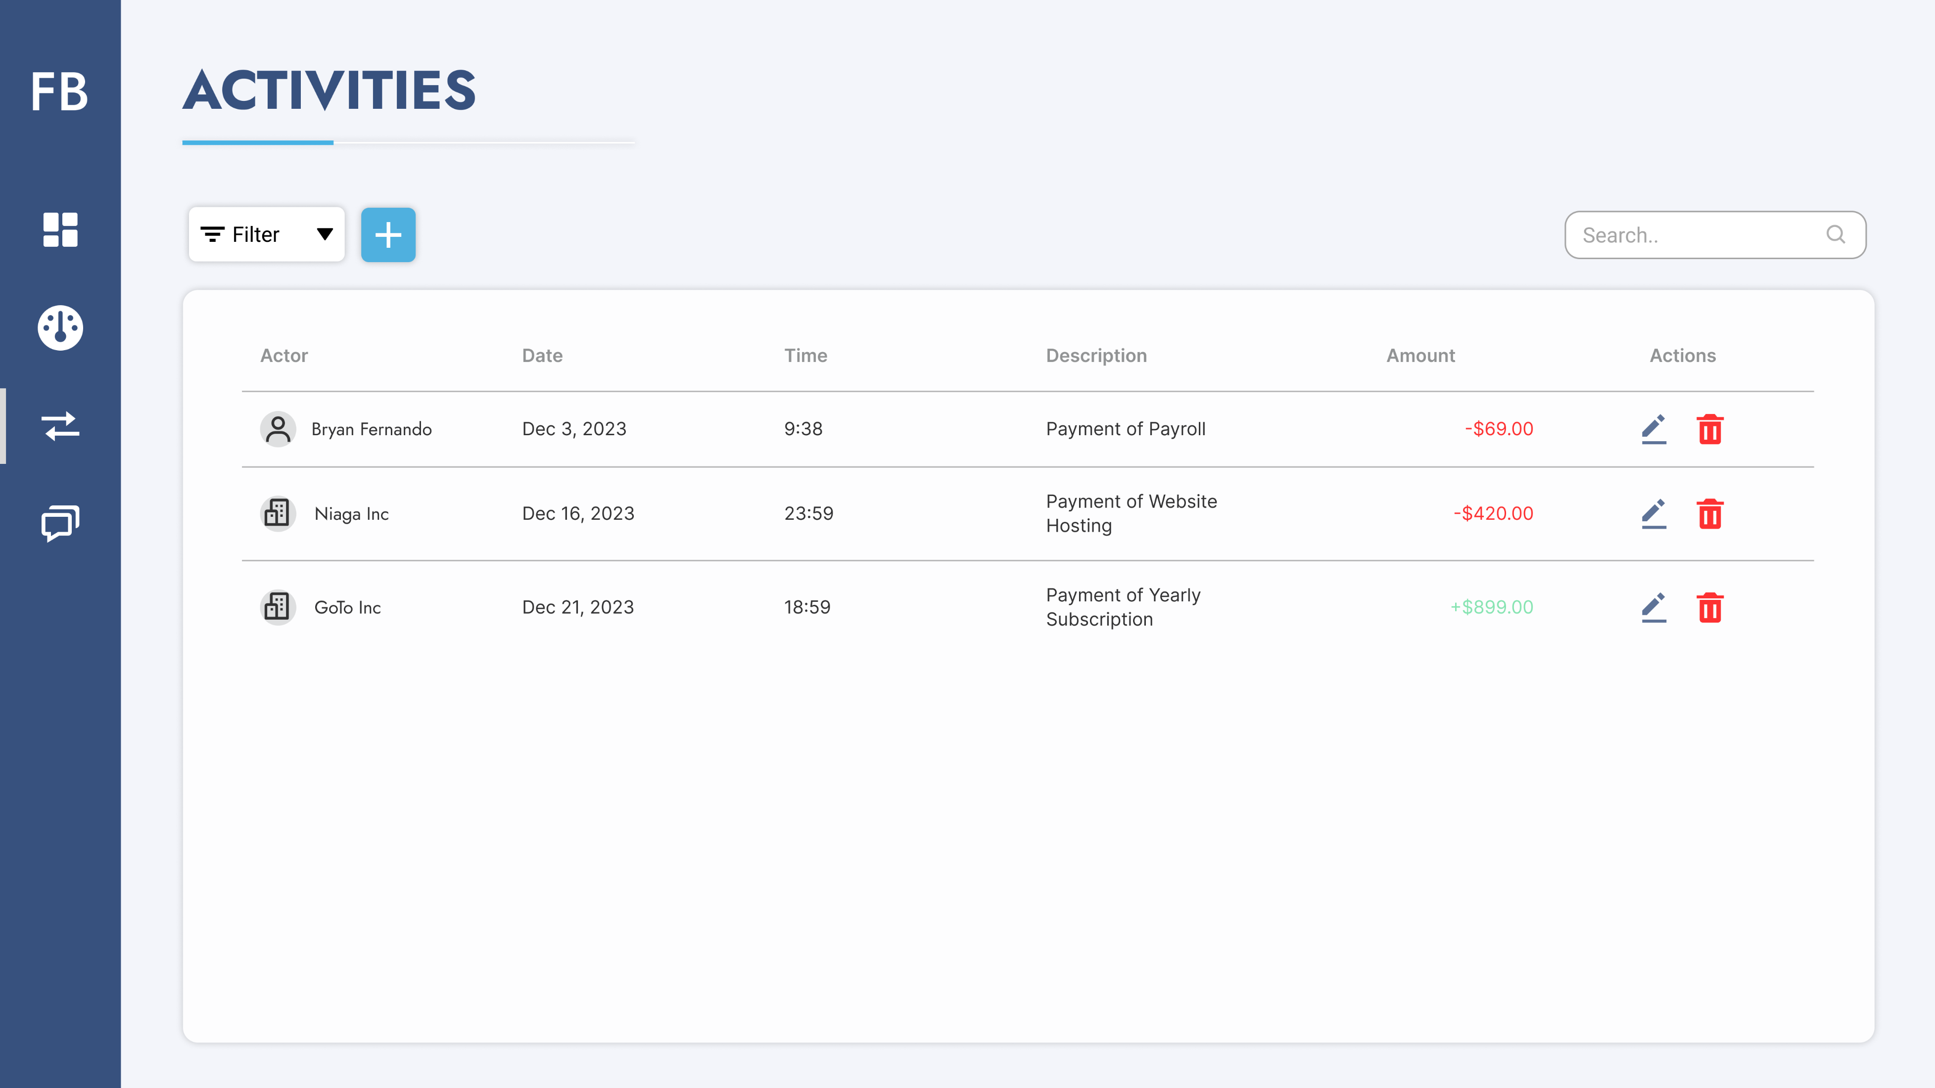
Activities

Slide 21
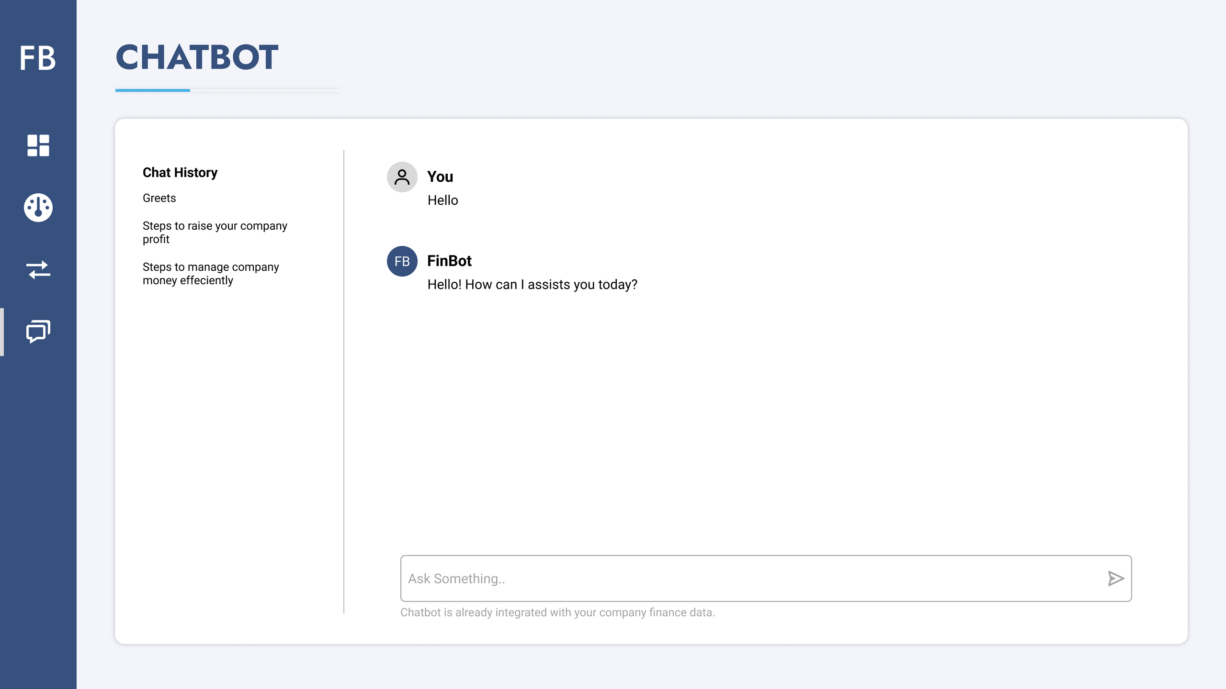
Chatbot

Slide 22
Selesai

